Slide 1

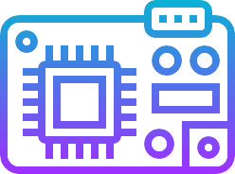
TORQUE
TEAM C: MAROON 5.0
1) Sai Charan Sanganwar
2) Neil J George
3) Yash Bharadwaj
4) Pranamya G Kulal
5) Mohith Charagondla
1

Slide 2




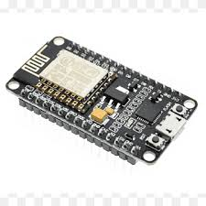



Objective
Develop a telematics system for real-time vehicle tracking and driver behavior analysis using ESP32 and motion sensors.
Technology Stack
Frontend: Flutter (Dart)
Backend: Firebase (Firestore, Auth)
Hardware: ESP32 microcontroller, accelerometer & gyroscope (MPU6050 a MEMS)
Development Tools: Arduino IDE (for ESP32 firmware), Firebase Console, Android Studio (for Flutter development).
Communication Protocols: Bluetooth Low Energy (BLE), UART (for sensor data).
2

Slide 3
Expectations
Elevations
A Mobile App connected to the dongle through bluetooth
Real-time location tracking displayed on a map using device’s coordinates
Low-cost telematics dongle prototype
Capture acceleration events with timestamps
Accident detection based on acceleration/velocity thresholds
Real-time data transmission to mobile app/cloud
Automatic email alerts to registered contacts in case of accidents
Interface for visualizing events and alerts
Data storage resilience
Stores data locally when online and syncs when there is internet availability
Latency ≤ 500ms for event logging
Power-efficient design
3

Slide 4
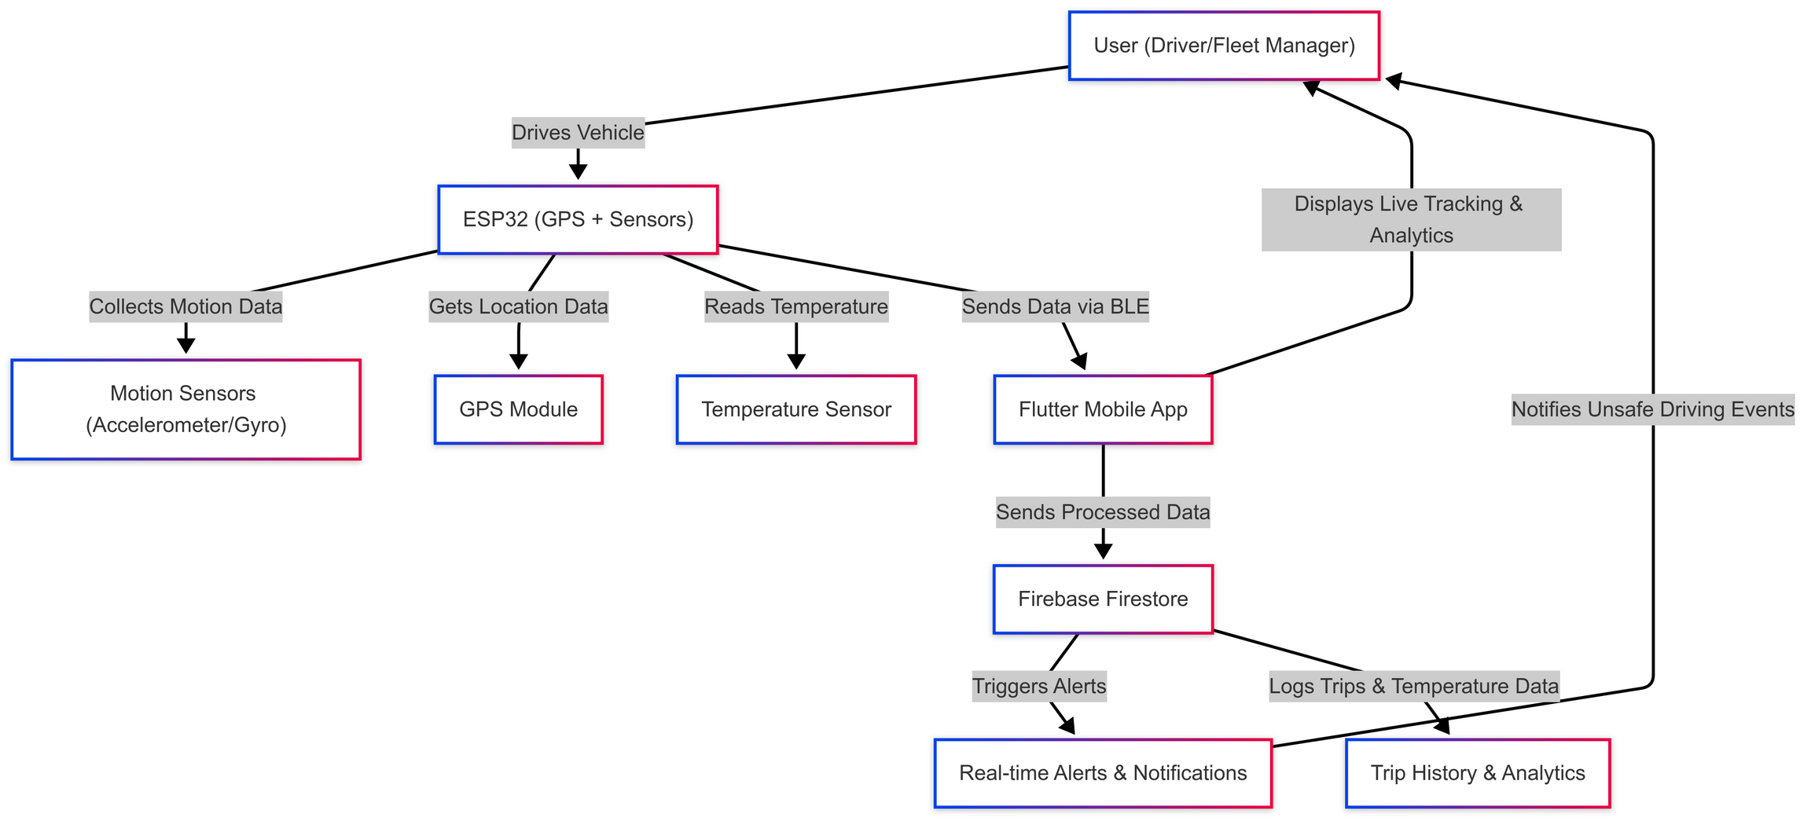
Flowchart
4

Slide 5
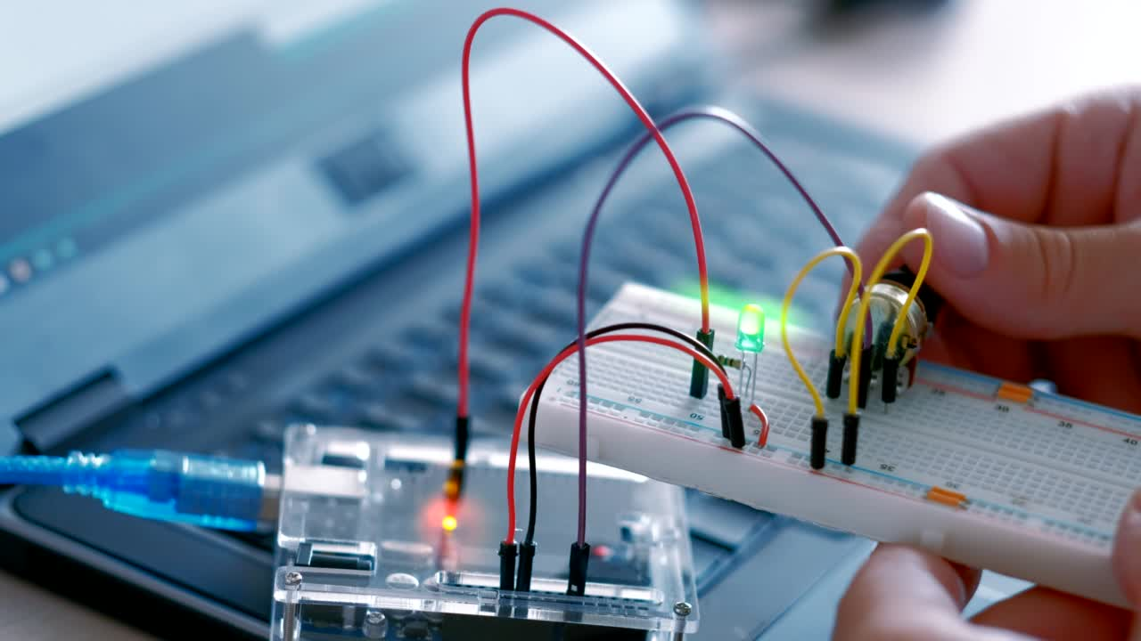




GPS TRACKING
Real-time vehicle ocation via ESP32 & GPS module
Core Features
Driver Behavior Analysis
Detects hard braking, rapid acceleration, and sharp turns with MPU6050 sensor.
GPS Tracking
Real-time vehicle location via ESP32 & GPS module
Cloud Integration
Data stored in Firebase Firestore for remote access.
User Authentication
Secure access with Firebase Auth.
Real-Time Alerts
Instant notifications for unsafe driving events.
Offline Mode with Data Sync
Stores data locally when offline and syncs when internet is available.
5

Slide 6
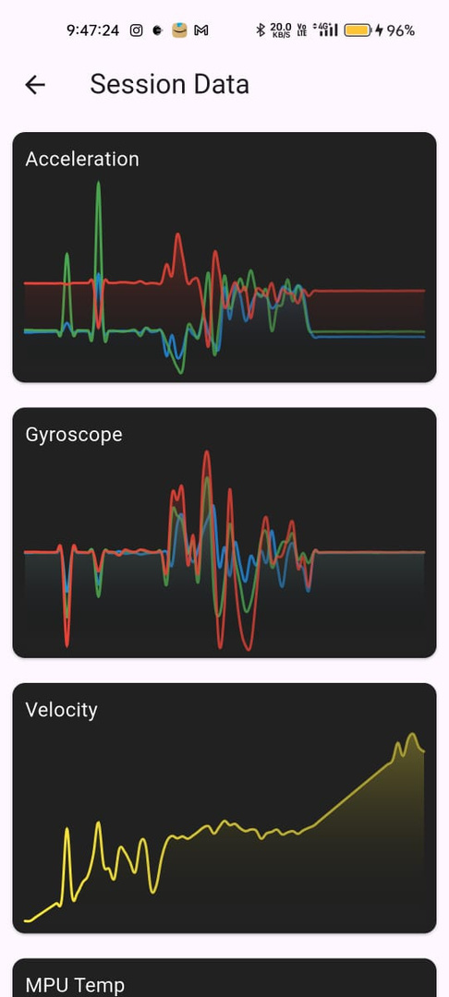
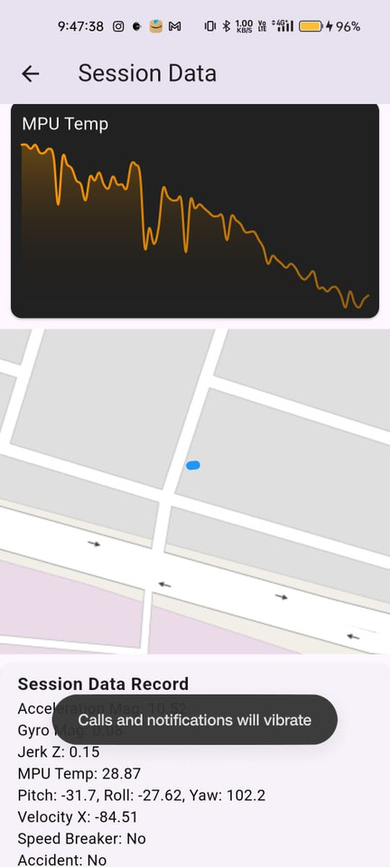
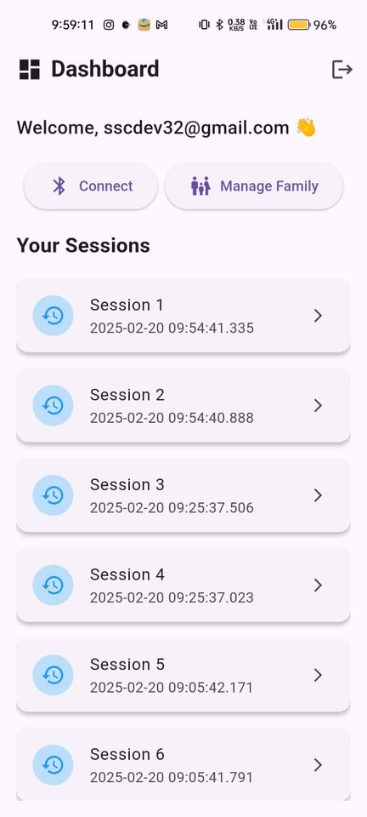
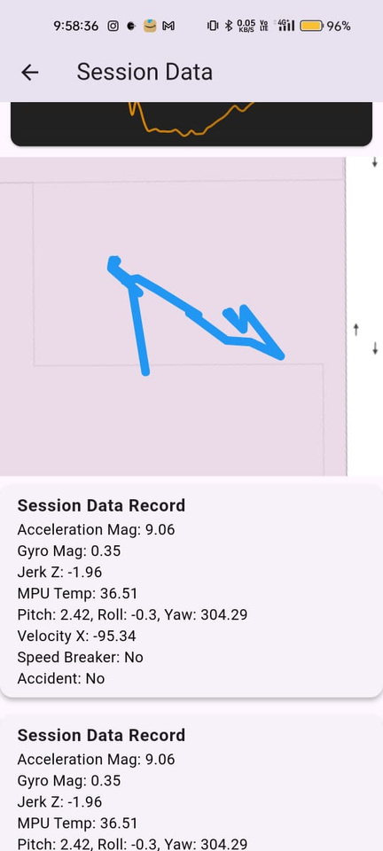
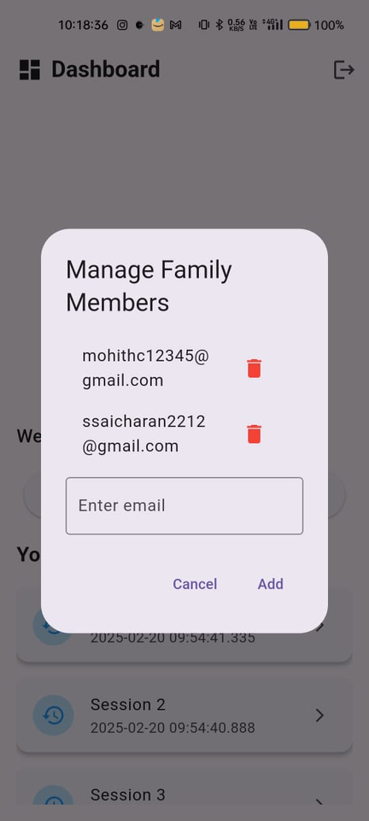
Supporting Screenshots
6

Slide 7




GPS TRACKING
Real-time vehicle ocation via ESP32 & GPS module
Why do we need the app ?
Difficulty in tracking vehicles due to lack of real-time monitoring.
Lack of real-time alerts for harsh braking, overspeeding, and sharp turns increases reckless driving risks.
Prevents
Lack of proof for safe driving and accident logs can lead to insurance and legal issues.
The need for an internet connection.
7

Slide 8

Market Anlaysis
Industry overview : The vehicle telematics market size was valued at USD 79.17 billion in 2023 and is projected to grow from USD 85.95 billion in 2024 to USD 170.35 billion by 2032, exhibiting a CAGR of 8.9% during the forecast period.
Source: https://www.fortunebusinessinsights.com/vehicle-telematics-market-102071
Target Market
Individual Vehicle Owners – Real-time tracking & driving analysis.
Fleet Operators & Logistics – Multi-vehicle tracking & cost optimization.
Ride-Sharing Services – Safety & trip monitoring.
Insurance Companies – Risk assessment & usage-based pricing.
Law Enforcement – Compliance & theft recovery.
8

Slide 9



Future Scope
AI-Powered Driver Insights 🧠 - Implement machine learning to classify driving patterns and provide personalized safety recommendations.
Voice-Assisted Commands 🎙️- Integration with Google Assistant & Alexa and enable voice-based trip insights & alerts.
Smart Fuel Optimization ⛽ - Predict fuel consumption based on driving habits and provides real-time fuel efficiency suggestions.
Blockchain for Secure Data Storage 🔒- Ensure tamper-proof driving logs & vehicle records and Improve insurance claims transparency.
Gamification & Rewards System 🎯- Introduce leaderboards & achievement badges and rewards users for safe driving habits.
Expansion to Smart Cities 🏙️- Partner with government agencies for traffic & urban planning and contribute to safer & smarter transportation ecosystems.
9

Slide 10

Bill of Materials (BOM) - aiming for a cost effective solution
Item No. | Component | Description | Quantity | Estimated Cost (Rs)
1 | ESP32 Dev Kit | Wi-Fi & BLE enabled microcontroller | 1 | 355
2 | MPU6050 | Accelerometer & gyroscope for motion sensing | 1 | 120
3 | PCB Board / Breadboard | Circuit assembly | 1 | 50
4 | Jumper Wires | Connection between components | 5 | 10
5 | Micro USB Cable | Power & data transfer for ESP32 | 1 | 80
6 | Flutter SDK | Cross platform mobile app development | - | Free
7 | Firebase Firetsore, authentication | Cloud databse for real time data storage and secure user authentication | - | Free
8 | Ardunio IDE | Firware Development for ESP32 | - | Free
9 | VS Code/ Android Studio | Flutter app development tools | - | Free
Total : Rs 615 | Total : Rs 615 | Total : Rs 615 | Total : Rs 615 | Total : Rs 615
10

Slide 11
THANK YOU
11

